Slide 1
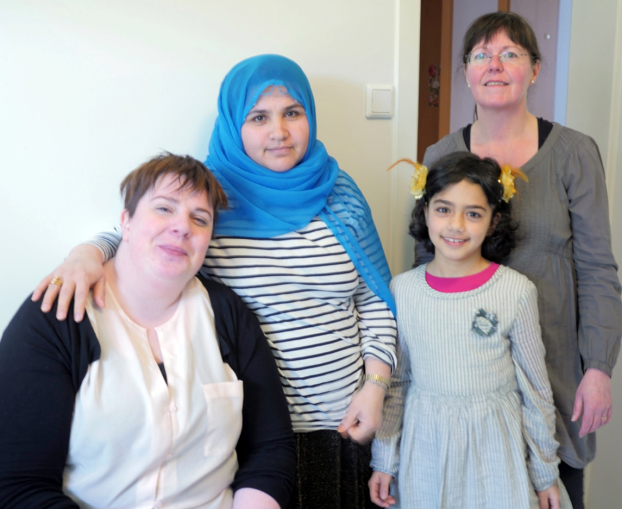
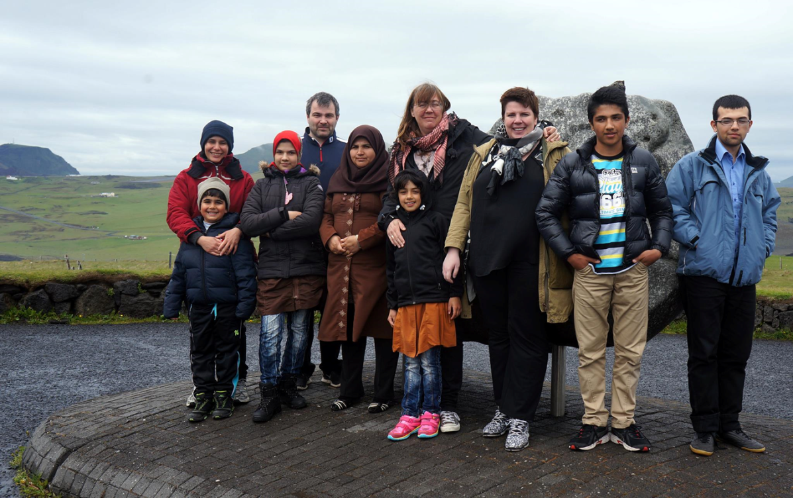
Hrafnhildur Kvaran - Icelandic Red Cross
The Refugees and Migrants
NGO Forum, April 11th – 12th, Warsaw

Slide 2
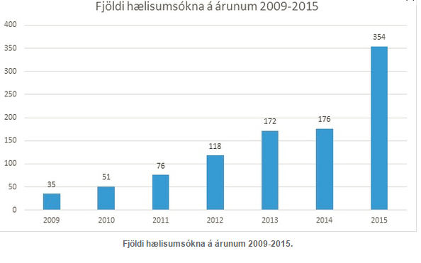
Asylum seekers in Iceland 2009 - 2015

Slide 3
Comparison 2014 – 2015 (1st quarter)

Slide 4
Legal assistance to asylum seekers
Started with a volunteer program from 2009-2011 and advocacy for the right to a legal representation
Red Cross took over all legal representation for asylum seekers in Iceland at administrative level from 25th August 2014
Asylum application per year in Iceland
2013: 172 or 0,5 per 1.000 inhabitants
2014: 174 or 0,5 per 1.000 inhabitants
2015: 358 or 1 per 1.000 inhabitants
2016: estimated approx. 600

Slide 5
Applying for asylum in Iceland
Notes:
Key words for translators (not on slides):
Schengen area / Shengen outpost / Shanegen border control

Slide 6
Challenges
Housing – shortage due to increased number of applications
Reception Centers→ many individuals have to share rooms
asylum procedures take longer time→ people need housing for a longer period of time
Change in combination of the group
more women and children – unaccompanied children
men who have been separated from their family → increase in family reunification cases
Negativity/Intolerance is growing towards asylum seekers
stereotypes and generalizations
Opportunities for participation are very important
opportunities for participation in meaningful occupations,
including work
Special needs of women and children
children´s right to education

Slide 7
Other support of the Icelandic Red Cross
Weekly open appointments where people can come and talk about their case, daily life, support they need, family matters, right to work, education etc.
Regular cloth donations
Weekly social activities
Volunteer work
Visitation service – support from volunteers
Restoring family links

Slide 8
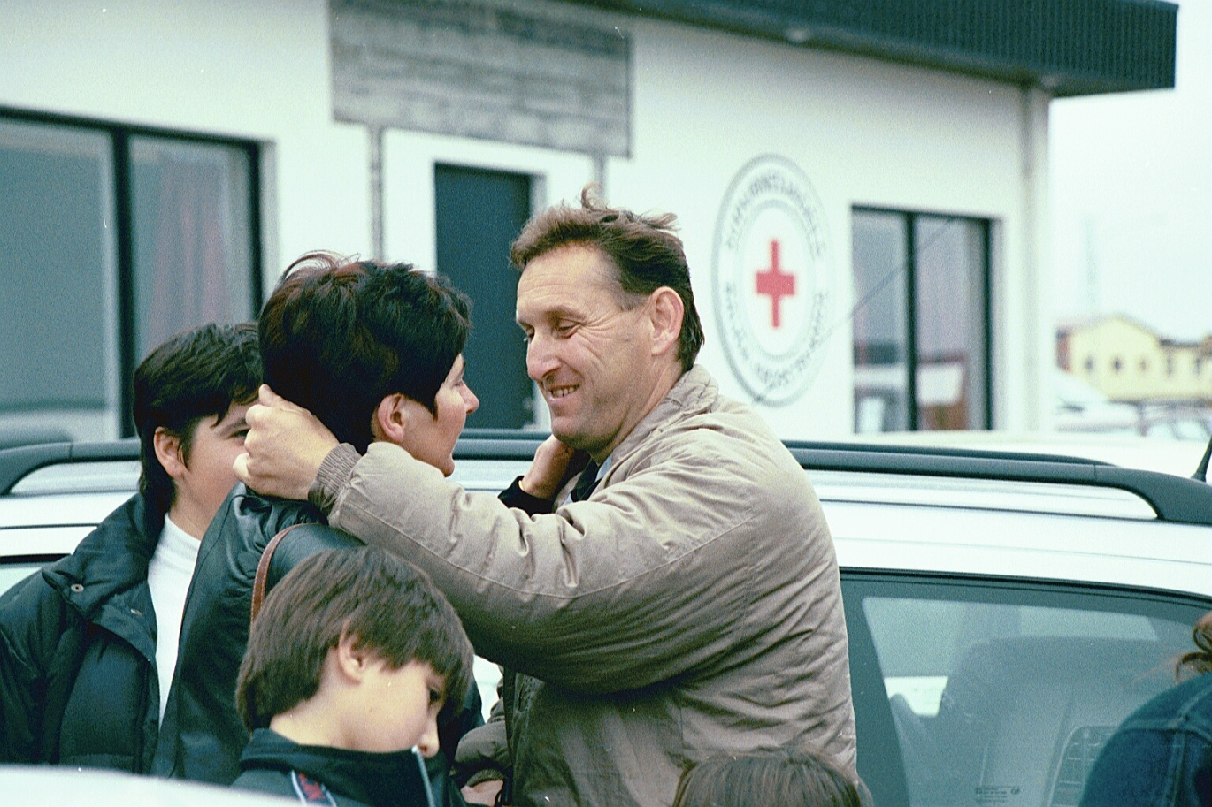
Social integration of refugees
A program run by the Icelandic Red Cross as a formal program from the 1990’s
Part of the Red Cross role in reception of resettled refugees in Iceland in cooperation with the Ministry of Welfare
Based on support families for the refugees
Iceland has focused on resettlement of vulnerable groups like women at risk, LGBTI and medical evacuation
Notes:
Key words for interpreters
The volunteer support for refugees started in late 1970´s
Advocacy for asylum seekers and refugees in Iceland
Human Rights issues

Slide 9
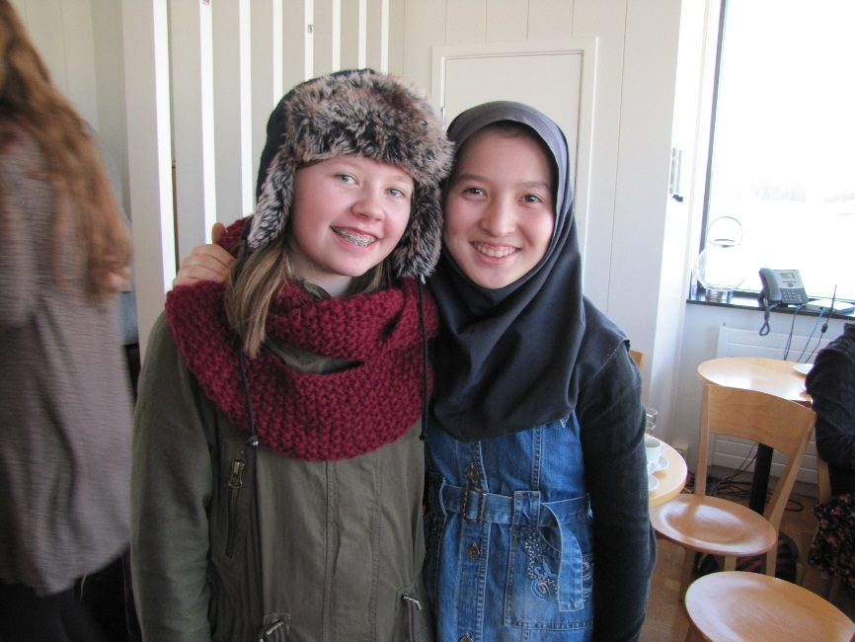
Why do we use family support system?
Important support during the first steps in a new country
Is important factor in social integration
Supports language learning
Promotes cultural understanding
Decreases xenophobia
Raises awareness about refugees
and the worlds refugee situation

Slide 10
Volunteers
Volunteers play a key role
Training and preparation is important
The refugee family gets 3-5 support families
The volunteer manager supports the volunteer support families during the 12 month program
Language knowledge is not necessary but patience is
Use technology to communicate and organize so the volunteers as a group give the best support
Confidentiality

Slide 11
The Refugees
Must have a voice when entering the program
Different people with different needs
Can feel pressure from their fellow countrymen to be ambassadors for their culture and good standards
Have to rely on interpreters for everything during the first months and that can feel like invasion to their private life
Need an opportunity to participate not only to receive

Slide 12
Integration – Protective factors
Three protective factors
Safety
Security
Time

Slide 13
Disillusion model
First introduced by León and Rebeca Grinberg (1984), is based on stages in the psychological process of adapting to one’s new country.2 A Canadian study has since shown that these stages only apply to the first ten to twelve months post-arrival in the host society.
The model distinguishes three different stages:
• Stage 1. Euphoria upon arrival: The ‘new arrival’ feels relieved and filled with hope.
• Stage 2. Disillusionment: The new arrival feels disillusioned and expresses feelings of homesickness. They wonder why they moved to the host society. Professor Beiser says that new arrivals are ‘at high risk for developing psychiatric disorders’ in this stage.
• Stage 3. Adaptation: The migrant feels more at home, adapts and starts to behave in conformity with local norms. Mental health problems diminish.
Notes:
first introduced by León and Rebeca Grinberg (1984), is based on stages in the psychological process of adapting to one’s new country.2 A Canadian study has since shown that these stages only apply to the first ten to twelve months post-arrival in the host society.

Slide 14
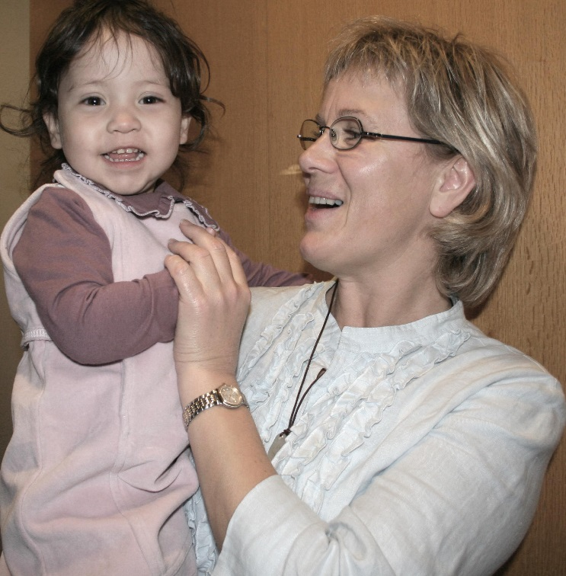
Challenges
Expect the unexpected
All involved being the Ministry, Municipality, Red Cross Staff or volunteers must work together
Take care of your volunteers they need support to be able to support
Prepare for misunderstandings
Be humble and accept you will make mistakes and have the courage to correct them
Notes:
Það er margt sem getur farið úrskeiðis svo þú þarft að vera tilbúinn til að vera sveigjanlegur, vinna á öllum tímum sólahrings í upphafi o.s.frv.
Samstarfið er lykilinn. Ef þeir sem standa að móttökunni vinna ekki saman þá fer þetta ekki vel – það verður að vera skýr verkefnastjórnun
Okkar hlutverk að hugsa vel um sjálfboðaliðana svo að þeir veiti góðan stuðning
Misskilningur verður á alla vegu – fara aðeins yfir það og hversu mikilvægt það er að játa mistök, leiðrétta misskilning og geta haft smá húmor fyrir sjálfum sér. Þetta er samvinnuverkefni allra sem koma að því, okkar, flóttafólksins og sjálfboðaliðanna. Öll munum við standa ríkari upp frá verkefninu og auka á víðsýni okkar.

